Slide 1
Artificial & Computational Intelligence
AIMLCZG557
Contributors & Designers of document content : Cluster Course Faculty Team
M3 : Game Playing
Presented by
Faculty Name
BITS Email ID

Slide 2

Artificial and Computational Intelligence
Disclaimer and Acknowledgement
Few content for these slides may have been obtained from prescribed books and various other source on the Internet
I hereby acknowledge all the contributors for their material and inputs and gratefully acknowledge people others who made their course materials freely available online.
.I have provided source information wherever necessary
This is not a full fledged reading materials. Students are requested to refer to the textbook w.r.t detailed content of the presentation deck that is expected to be shared over e-learning portal - taxilla.
I have added and modified the content to suit the requirements of the class dynamics & live session’s lecture delivery flow for presentation
Slide Source / Preparation / Review:
From BITS Pilani WILP: Prof.Raja vadhana, Prof. Indumathi, Prof.Sangeetha
From BITS Oncampus & External : Mr.Santosh GSK

Slide 3
Course Plan
M1 | Introduction to AI
M2 | Problem Solving Agent using Search
M3 | Game Playing
M4 | Knowledge Representation using Logics
M5 | Probabilistic Representation and Reasoning
M6 | Reasoning over time
M7 | Ethics in AI

Slide 4
Module 3 : Searching to play games
Min-max Algorithm
Alpha-Beta Pruning
C. Making imperfect real time decisions

Slide 5
Learning Objective
At the end of this class , students Should be able to:
Convert a given problem into adversarial search problem
Formulate the problem solving agent components
Design static evaluation function value for a problem
Construct a Game tree
Apply Min-Max
Apply and list nodes pruned by alpha pruning and nodes pruned by beta
pruning

Slide 6

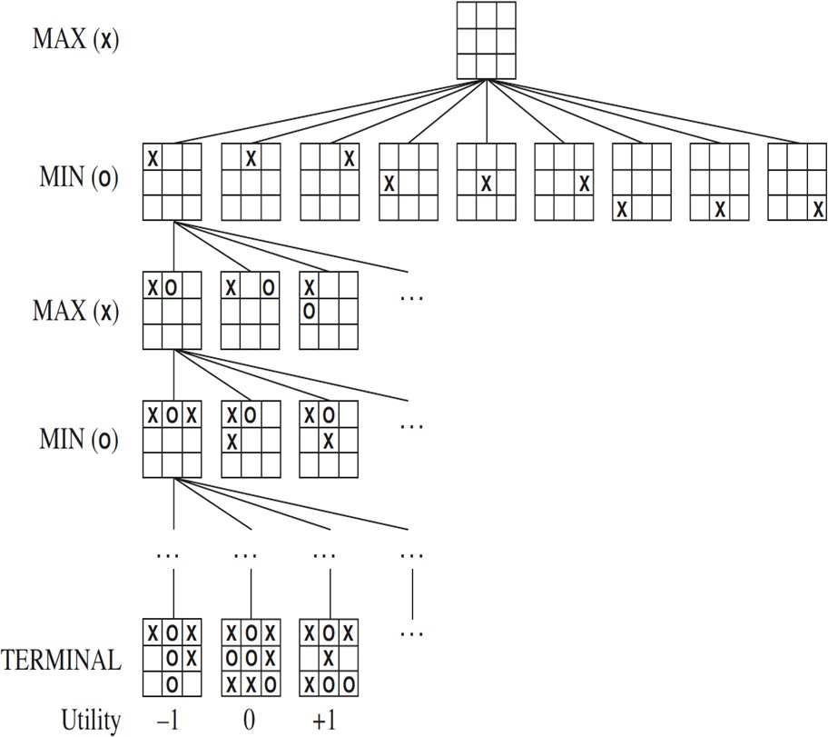
Task Environment
Phases of Solution Search by PSA
Assumptions – Environment :
Static (4.5) Observable Discrete (4.4) Deterministic Number of Agents

Slide 7
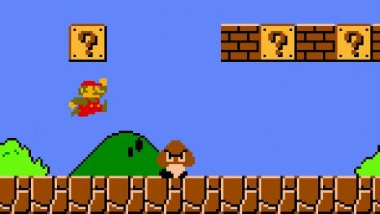
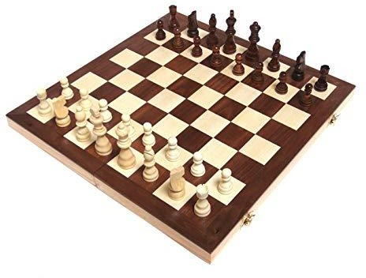
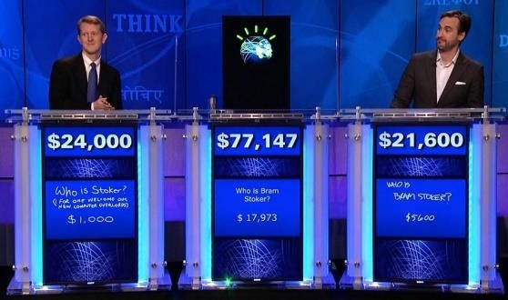
Game Problem
Study & design of games enables the computers to model ways in which humans think &
act hence simulating human intelligence.
AI for Gaming:
Interesting & Challenging Problem
Larger Search Space Vs Smaller Solutions
Explore to better the Human Computer Interaction
Characteristics of Games:
Observability
Stochasticity
Time granularity
Number of players
Adversarial Games:
Goals of agents are in conflict where one’s optimized step would reduce the utility value of the other.

Slide 8

Single Player Game
as Constraint Satisfaction Problem An Overview - Sudoku
BITS Pilani, Deemed to be University under Section 3 of UGC Act, 1956

Slide 9

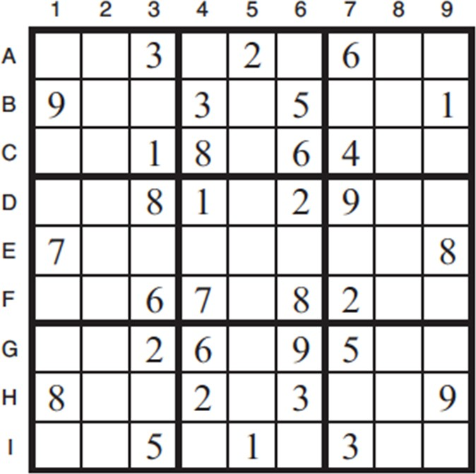
Problem Formulation
Total variables = 81
– One for each square
– X = {A1, A2, A3, ..., A9, B1, B2, …}
Domains
— Empty Squares has {1, 2, 3, 4, 5, 6, 7, 8, 9}
  Filled Squares has only one value as provided
Constraints
  A1 – A9 should all be distinct, …
  A1 – I1 should all be distinct, …
  A1-3, B1-3, C1-3 should all be distinct

Slide 10
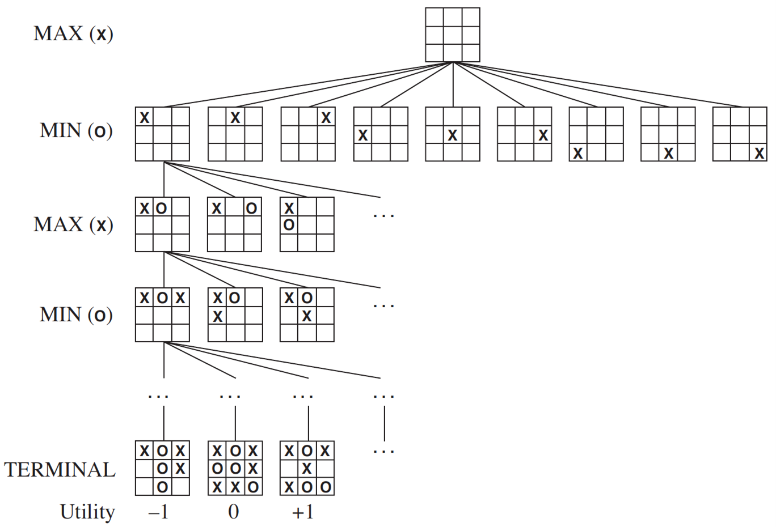
Games as Search Problem
PSA : Representation of Game:
INITIAL STATE: S0 PLAYER(s) ACTIONS(s) RESULT(s, a) TERMINAL-TEST(s) UTILITY(s, p)
Eg., Tic Tac Toe

Slide 11

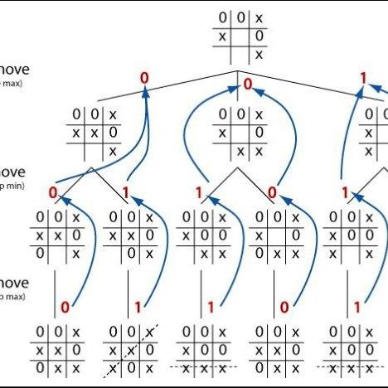
Min-Max Algorithm
Idea: Uses Depth – First search exploration to
decide the move
Let
start Player = MAX Depth m =3

Slide 12
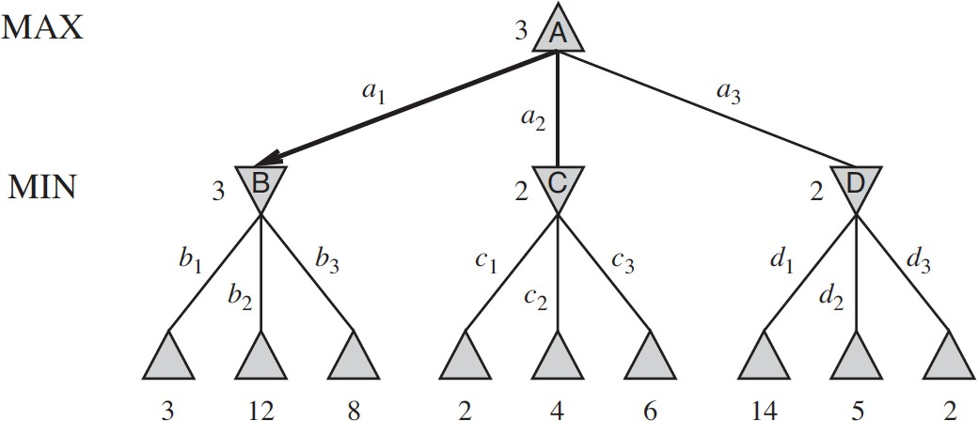
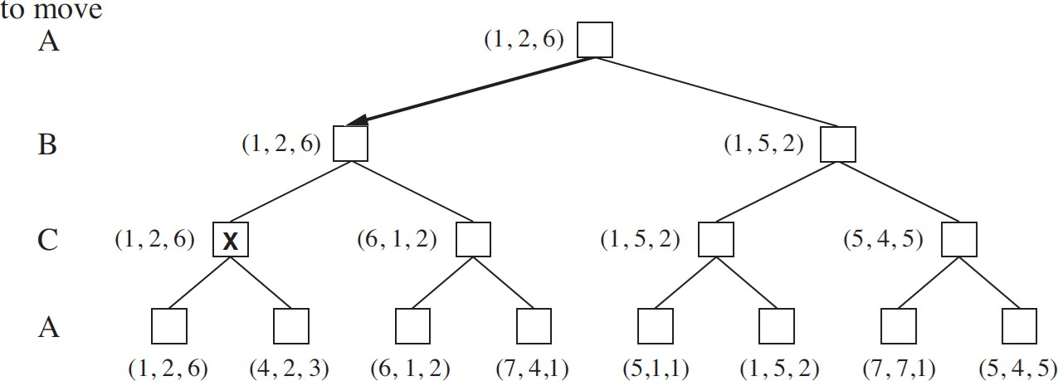
Two Player Game : - 2 Ply Game
Multiplayer Game

Slide 13
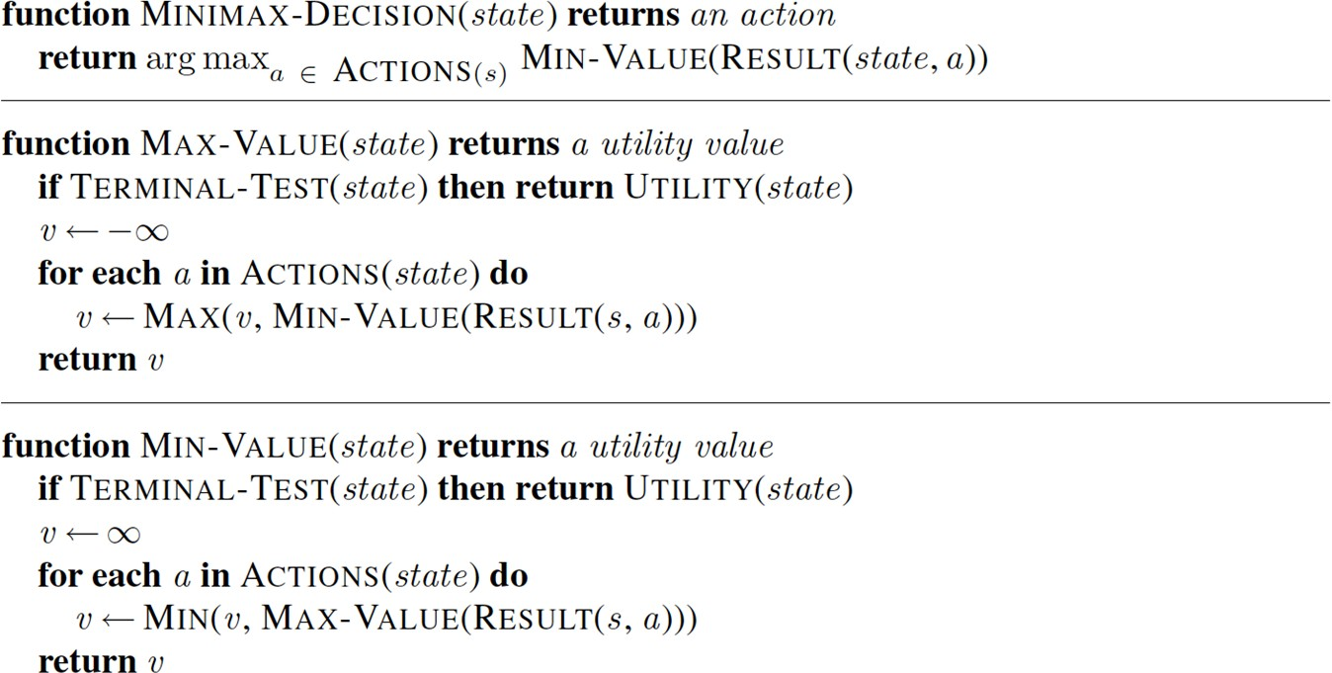
Min-Max Algorithm

Slide 14
Min-Max Algorithm – Example -1
Squares represent MAX nodes
Circles represent MIN nodes
8
7
8
7
8
8
9
3
-
8
9
-
7
8
10
1
3
8 | 7 | 3 | 15 | 9 | 8 | -10 | 5 | 1 | 4 | 8 | 9 | 9 | 9 | 12 | -3

Slide 15
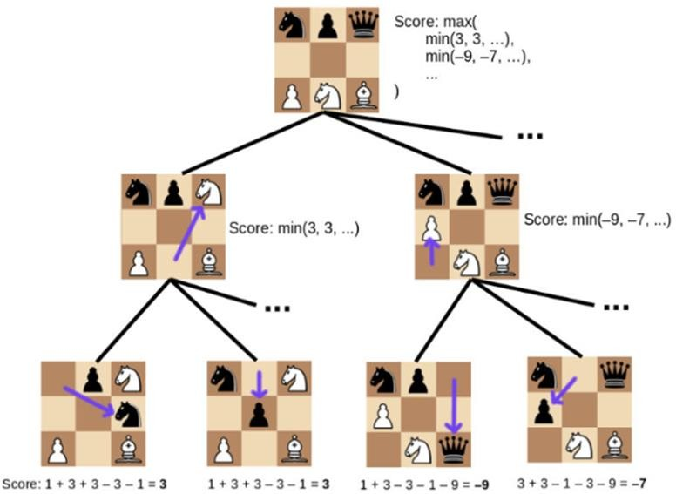
Design of Static Evaluation Values

Slide 16
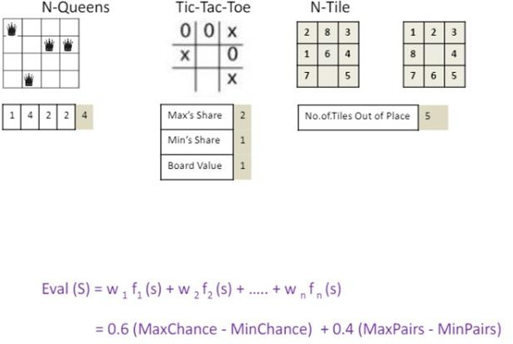
Design of Static Evaluation Values

Slide 17
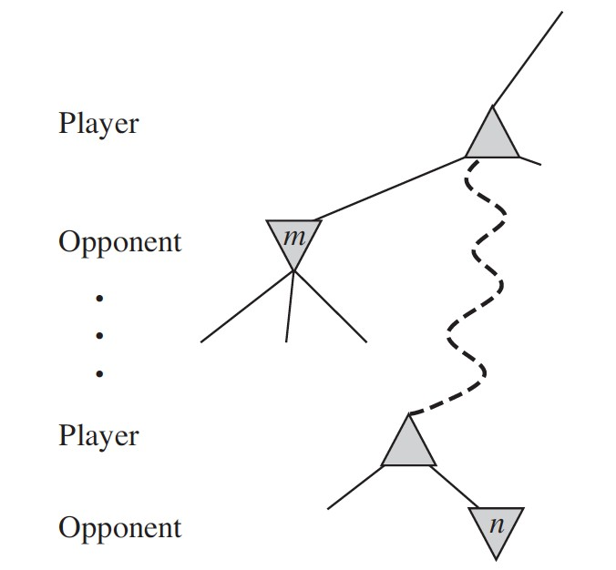
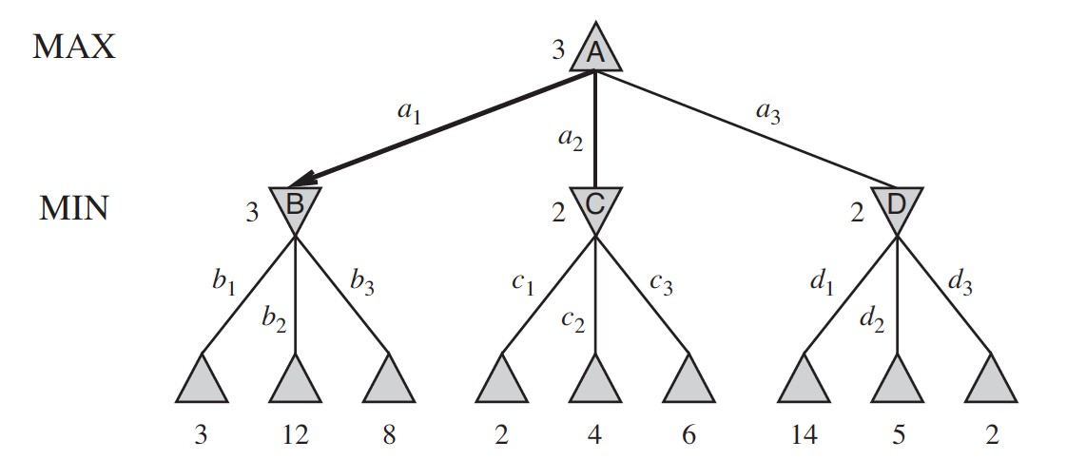
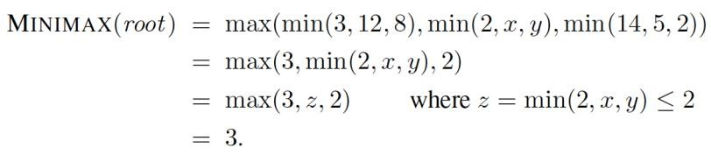
Alpha – beta Pruning
General Principle:
At a node n if a player has better option at the parent of n or further up, then n node will never be reached .Hence the entire subtree from node n can be pruned

Slide 18
Alpha Beta Pruning
Book Example

Slide 19
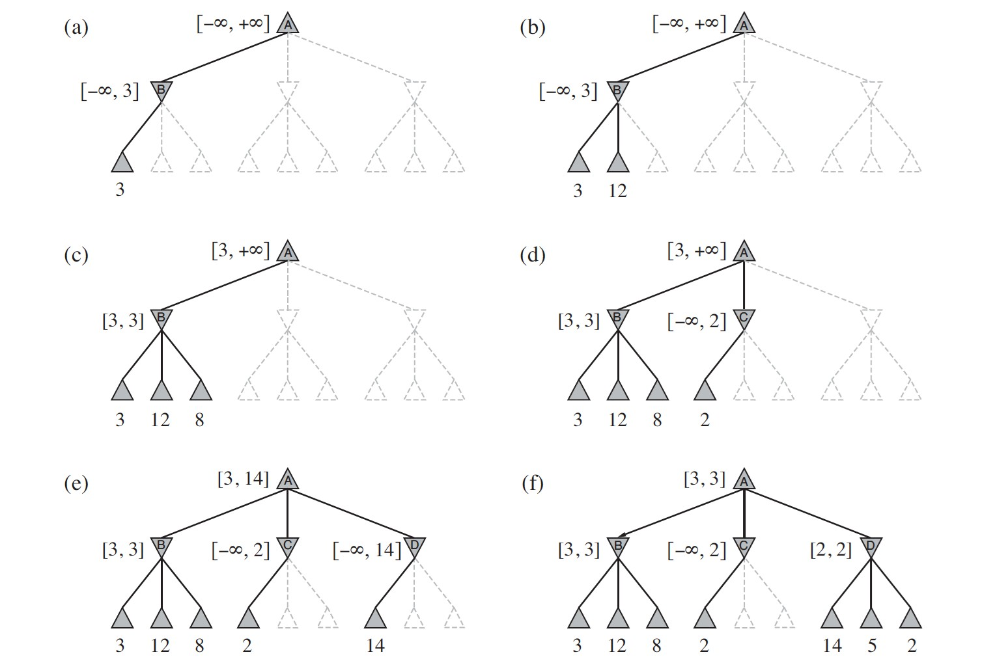
Alpha Beta Pruning
Book Example

Slide 20
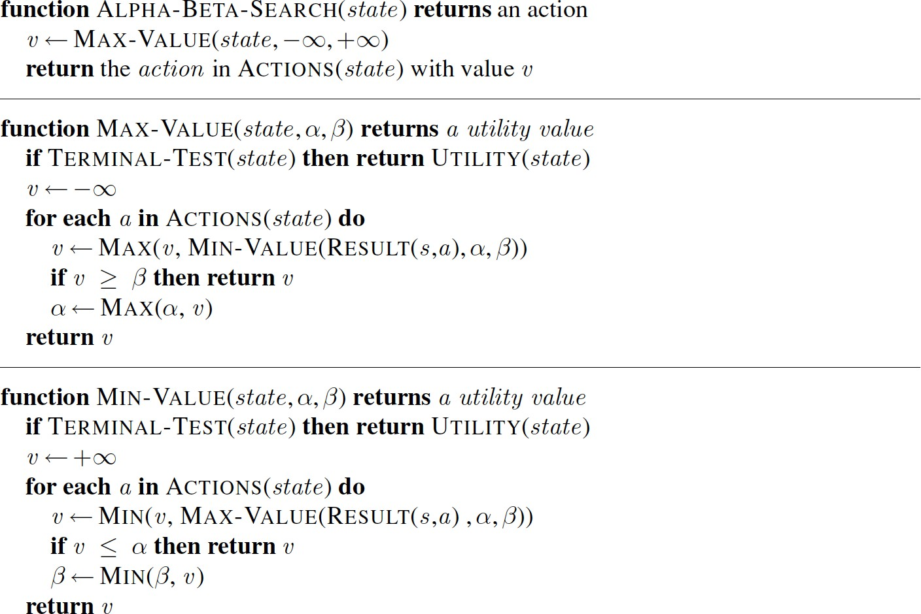
Min-Max Algorithm
Alpha beta Modifications
Is it possible to compute the minimax decision for a node without looking at every
successor node?

Slide 21
Alpha – beta Pruning
Steps in Alpha – Beta Pruning:
At root initialize alpha = -∞ and beta = + ∞. This is to set the worst case boundary to start the
algorithm which aims to increase alpha and decrease beta as much as optimally possible
Navigate till the depth / limit specified and get the static evaluated numeric value.
For every value VAL being analyzed : Loop till all the leaf/terminal/specified state level nodes are
analyzed & accounted for OR until beta <= alpha.
  If the player is MAX :
    If VAL > alpha
    then reset alpha = VAL
    also check if beta <=alpha then tag the path as unpromising (TO BE AVOIDED) and prune the branch from game tree. Rest of their siblings are not considered for analysis
  Else if the player is MIN:
    If VAL < beta
    then reset beta = VAL
    also check if beta <=alpha then tag the path as unpromising (TO BE AVOIDED) and prune the branch from game tree. Rest of their siblings are not considered for analysis

Slide 22
Alpha Beta Pruning - Another Example
Idea –Pruning
A
B
C
C
D
E
F
6 | 5 | 8 | 10 | 2 | 1 | 9 | 12

Slide 23
Alpha Beta Pruning
Idea –Pruning
A
B
C
𝖺=6
D
E
F
6 | 5 | 8 | 10 | 2 | 1 | 9 | 12

Slide 24
Alpha Beta Pruning
Idea –Pruning
A
ᵦ=
6
C
𝖺=6
D
E
F
6 |  | 5 | 8 | 10 | 2 | 1 | 9 | 12

Slide 25
Alpha Beta Pruning
Idea – Alpha Pruning
A
ᵦ=
6
C
𝖺=6
𝖺=8
E
F
6 |  | 5 |  | 8 | 10 | 2 | 1 | 9 | 12

Slide 26
Alpha Beta Pruning
Idea – Beta Pruning
A
ᵦ=
6
C
𝖺=6
𝖺=8
E
F
6
5
8
10
2
1
9
12

Slide 27
Alpha Beta Pruning
Idea –Pruning
𝖺=6
ᵦ=
6
C
𝖺=6
𝖺=8
E
F
6
5
8
10
2
1
9
12

Slide 28
Alpha Beta Pruning
Idea –Pruning
𝖺=6
ᵦ=
6
C
𝖺=6
𝖺=8
𝖺=2
F
6
5
8
10
2
1
9
12

Slide 29
Alpha Beta Pruning
Idea –Pruning
𝖺=6
ᵦ=
6
ᵦ=
2
𝖺=6
𝖺=8
𝖺=2
F
6
5
8
10
2
1
9
12

Slide 30
Alpha Beta Pruning
Idea – Alpha Pruning
6
<
2?
6
6
8
2
6 | 5 | 8 | 10 | 2 | 1 | 9 | 12
Alpha – Lower bound of Maximizer’s value. Perceived value that Maximizer hopes to
against a competitive Minimizer

Slide 31
Alpha – beta Pruning– Example -4 Do for practice.
Alpha – Lower bound of Maximizer’s value. Perceived value that Maximizer hopes to get with a competitive Minimizer
Beta – Upper Bound of Minimizer’s value.
8 | 7 | 3 | 15 | 9 | 8 | -10 | 5 | 1 | 4 | 8 | 9 | 9 | 9 | 12 | -3

Slide 32
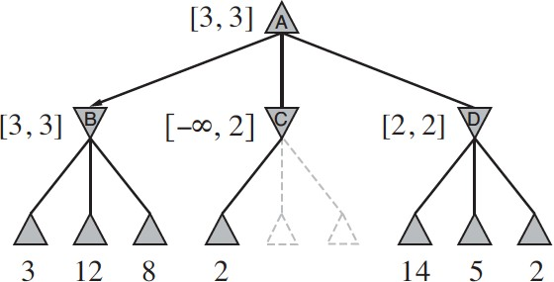
Computational Efficiency
How to reduce the move generations better along while doing Alpha-Beta Pruning?

Slide 33

After Move Ordering
Before Move Ordering
=3
=7
2
2
4
3
8
7
3
15 8
7
3
15 4
3

Slide 34
Gaming
(Imperfect Decisions)
BITS Pilani, Deemed to be University under Section 3 of UGC Act, 1956

Slide 35
Computational Efficiency
How games can be designed to handle imperfect decisions in real-time?

Slide 36
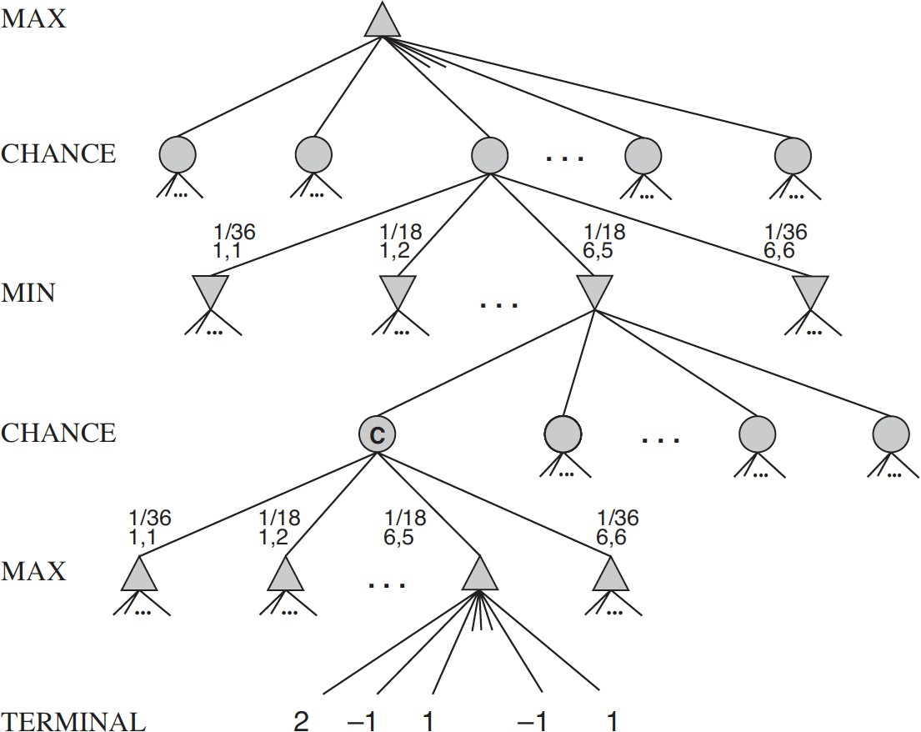
Computational Efficiency
Idea : Chance Node:
Holds the expected values that are computed as a sum of all outcomes weighted by their probability (of dice roll)

Slide 37
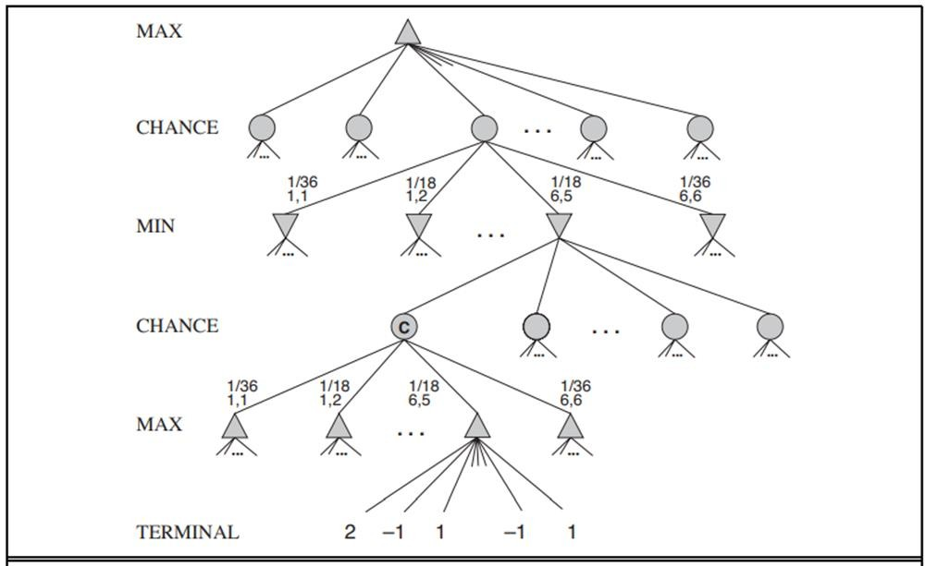
Expecti Mini Max Algorithm

Slide 38
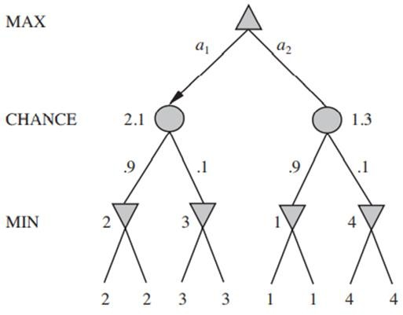
Expecti Min Max Algorithm

Slide 39
= 4.4 (0.3) + 3(0.7)
= 3.42
4(0.6)+10(0.4)
=6.4
0.3 | 0.7 | 0.6 | 0.4
min ( 4(0.8)+6(0.2) , 6)
= min (4.4, 6)
= 4.4
0.8 | 0.2 | 3 | 7 | 4 | 10
4 | 6 | 3 | 6

Slide 40
Game Playing (Interesting Case Studies)
BITS Pilani, Deemed to be University under Section 3 of UGC Act, 1956

Slide 41
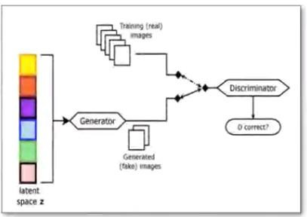
Games in Image Processing
Source Credit:
2019 - Analyzing and Improving the Image Quality of StyleGAN
Tero Karras, Samuli Laine, Miika Aittala, Janne Hellsten, Jaakko Lehtinen, Timo Aila
https://thispersondoesnotexist.com/

Slide 42
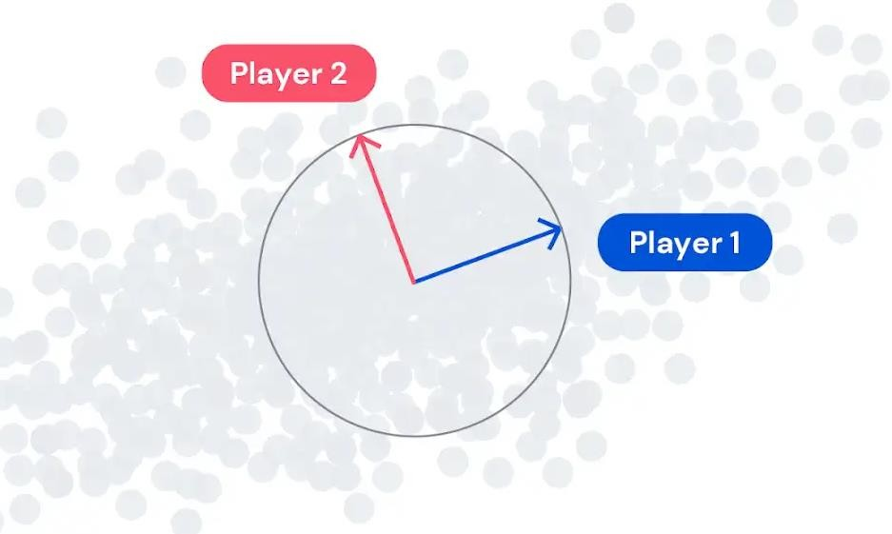
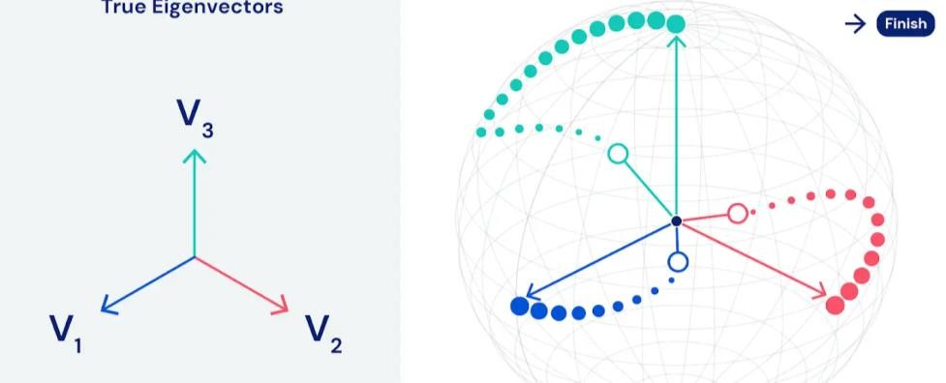
Games in Feature Engineering
Source Credit:
https://deepmind.com/blog/article/EigenGame
2021 - EigenGame: PCA as a Nash Equilibrium , Ian Gemp, Brian McWilliams, Claire Vernade, Thore Graepel

Slide 43
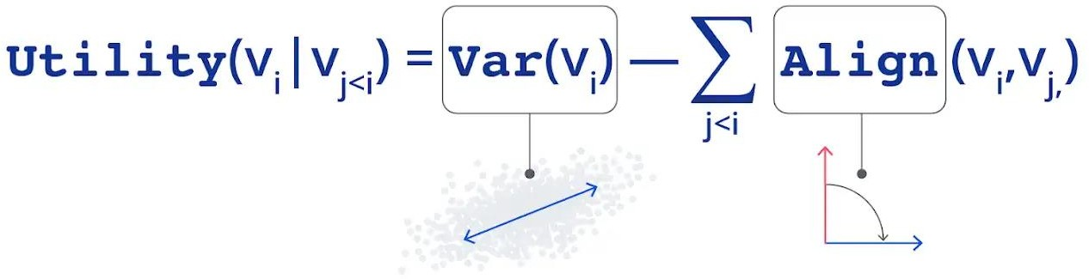
Games in Feature Engineering
Source Credit:
https://deepmind.com/blog/article/EigenGame
2021 - EigenGame: PCA as a Nash Equilibrium , Ian Gemp, Brian McWilliams, Claire Vernade, Thore Graepel

Slide 44
Required Reading: AIMA - Chapter # 4.1, #4.2, #5.1
Thank You for all your Attention
Note : Some of the slides are adopted from AIMA TB materials

